Slide 1
Anisotropic Gaussian Mutations for Metropolis Light Transport through Hessian-Hamiltonian Dynamics
Tzu-Mao Li¹ Jaakko Lehtinen^{2,3} Ravi Ramamoorthi⁴
Wenzel Jakob⁵ Frédo Durand¹
¹MIT CSAIL ²Aalto University ³NVIDIA
4UC San Diego 5ETH Zürich
Notes:
This is a presentation about a new general rendering algorithm dealing with difficult light paths.

Slide 2
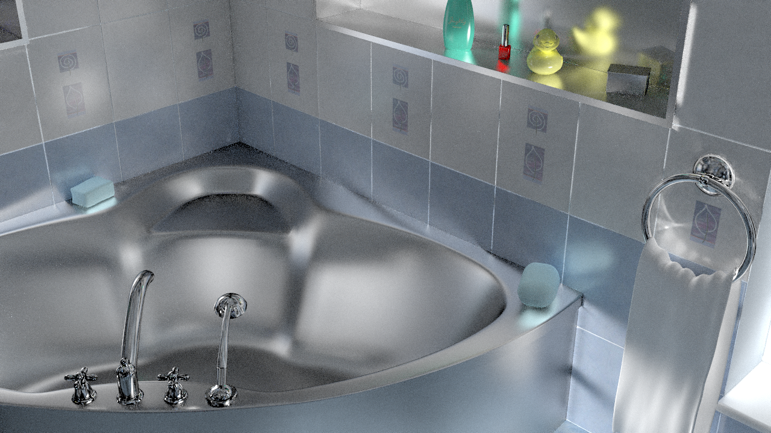
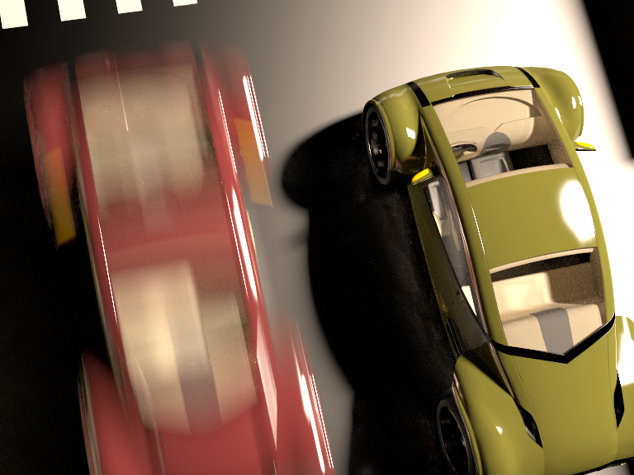
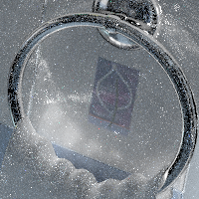
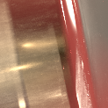
Motivation: rendering difficult light paths
e.g. multi-bounce glossy light paths combined with motion blur
narrow contribution regions
can lead to noisy images
Notes:
We focus on rendering scenes with difficult light paths, such as the ones that contain multiple glossy materials, possibly combining with other effects like motion blur
These light paths are difficult to render because their contribution regions are usually sparse and narrow.
It can makes your image noisy if you don’t have enough samples.

Slide 3
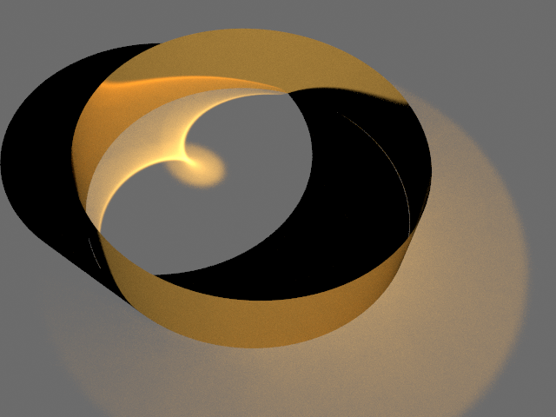
The ring example
light
Notes:
To illustrate why this is difficult and how we plan to deal with it, let’s look at this scene, where there is a highly-glossy gold ring lit by a distant point light

Slide 4
The ring example
light
Notes:
Let’s focus on the the light paths in the red region
Let me zoom in to have a clearer view.

Slide 5
The ring example
light

Slide 6
Path contribution varies
depends on geometry, BRDF, light, etc
light
vertex 1
vertex 2
lots of light!
Notes:
Here’s a light path connecting from the light to the eye. It has high contribution because the glossy material on vertex 1 above is reflecting many photons towards vertex 2 below.
Now we want to look at the nearby light paths.
The nearby light paths can have very different contribution compare to the original light path.
In general this is due to a variety of factors such as the curvature of the surfaces, the material properties, and light position.

Slide 7
Path contribution varies
depends on geometry, BRDF, light, etc
not
much light
light
vertex 1
vertex 2
lots of light!
Notes:
For example, if you move vertex 1 to another position, it is very likely that the new light path will go off the peak of the glossy reflection and does not contribute to the image

Slide 8
Path contribution varies
depends on geometry, BRDF, light, etc
light
vertex 1
not
much light
vertex 2
lots of light!
Notes:
and the same thing happens if you try to move vertex 2
Let’s try to visualize the contribution function by moving these two vertices on the corresponding direction

Slide 9
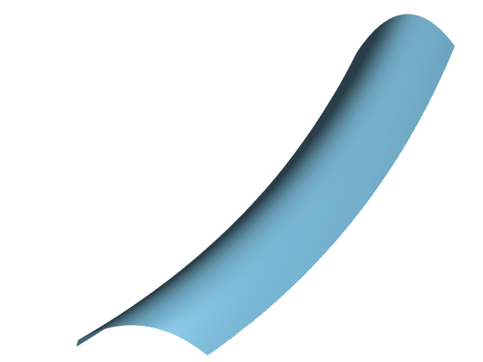
Visualization of path space contribution
paths → 2D horizontal locations
contribution → up direction
narrow & anisotropic
zero contrib.
contribution
vertex 1
zero contrib.
vertex 2
vertex 1
vertex 2
x
Notes:
And we get the plot on the right.
Every point on the horizontal coordinates correspond to a light path with different offsets in blue and red directions.
We record the light path contribution on the axis pointing up and we draw this 3d landscape of path contribution.
For example, the yellow sample on the center of the plot corresponds to the original light path. (animate)
Red and blue sample represents the light path with moved vertex 1 and vertex 2 correspondingly. (animate*2)
What you can observe here is that while the contribution is continuous, it is both sparse and anisotropic.
By anisotropic I mean the function usually has different degree of smoothness at different directions.
The sparsity and anisotropy are causing some troubles to us.
For example, if you only move one of the vertices, it is very likely that your new path will have zero contribution like the red or blue samples.

Slide 10
Visualization of path space contribution
paths → 2D horizontal locations
contribution → up direction
narrow & anisotropic
zero contrib.
contribution
vertex 1
zero contrib.
vertex 2
vertex 1
vertex 2
x
Notes:
And what we get is something like the plot on the right.
The center of the contribution function corresponds to the original light path.
The horizontal coordinates correspond to different light paths as we move the vertices in red and blue directions.
We record the light path contribution on the axis pointing up and we draw this 3d landscape of path contribution.
What you can observe here is that while the contribution is continuous, it is both sparse and anisotropic.
By anisotropic I mean the function usually has different degree of smoothness at different directions.
The sparsity and anisotropy are causing some troubles to us.
For example, if you only move one of the vertices, it is very likely that your new path will have zero contribution.

Slide 11
Monte Carlo: inefficient!
don’t know contribution function, can only sample it
few samples in high contribution region
zero
contrib.
positive
contrib.
zero
contrib.
Notes:
Traditional Monte Carlo sampling is not very efficient on this narrow function.
Notice that, we don’t actually know the whole contribution function.
What we can do here is to shoot point sample on it.
Unfortunately, many of the samples do not contribute to the image at all, and this is the source of the noise.

Slide 12
Metropolis Light Transport [Veach 1997]
idea: stays in high contribution region with Markov chain
sample n+2
sample n
sample n+1
Notes:
There is a more advanced rendering algorithm called Metropolis Light Transport.
The idea is to maintain a Markov chain of light path samples to stay in the high contribution region.
Given the yellow sample in the center, we try to generate sample n+1 around the yellow sample, and we try to generate n+2 around n+1, and so on

Slide 13
Metropolis Light Transport [Veach 1997]
idea: stays in high contribution region with Markov chain
sample n+1 drawn from proposal distribution
sample n+1
proposal
distribution
Notes:
To generate sample n+1, we draw a proposal from a proposal distribution.
The proposals are probabilistically accepted to become the next state.

Slide 14
Metropolis Light Transport [Veach 1997]
problem:
proposals with low contribution are probabilistically rejected
rejected
rejected
rejected
rejected
Notes:
However, the choice of proposal distribution is crucial.
It needs to be similar to the contribution function at least locally,
because the probability of rejecting the proposals depends on their contributions.
Low contribution proposals will end up being rejected.
The fact that the contribution function is anisotropic makes this difficult, because you can’t just blindly move the vertices of the light path.

Slide 15
Our goal: anisotropic proposal
  proposal stays in high contribution region
proposal
distribution
Notes:
Our method builds on Metropolis Light Transport, and we focus on building an efficient local sampling strategy, so that the proposals stay in high contribution regions.
The goal is to generate new proposals, so that they adapt to the anisotropy of the integrand.
In other word, we want the proposal has high probability to land on high contribution region, so that we can explore the contribution function while reducing the probability of rejection.

Slide 16
Previous work [Jakob 2012, Kaplanyan 2014]
  specialized for microfacet BRDF & mirror directions
  proposal in special directions
Notes:
There are some previous works on efficient local sampling for metropolis light transport specialized for microfacet BRDFs.
They utilize constraints based on the mirror directions to sample the light paths.
Our method is different in two aspects.
First, we aim for a fully general approach, for example, our method can be easily extended to time dimension and detect the anisotropy of a moving multi-bounce glossy light path.
Second, we want to characterize the anisotropy of all directions at once, and these specialized methods need to sample from some dimensions first, then resolve the rest using the constraints.

Slide 17
Our goal: anisotropic proposal
  proposal stays in high contribution region
  fully general approach
proposal
distribution
Notes:
So, let me restate our goal.
We build on Metropolis light transport, and try to come up with a proposal distribution that adapts to the anisotropy of the integrand.
We want the proposal to have higher probability to land on high contribution region.
We also want our method to be fully general so that we can use it to render any effects.

Slide 18
Challenges & our solutions
1: characterize anisotropy
use 2nd derivatives (Hessian)
→quadratic approximation
2: sample quadratic
(not distributions!)
simulate Hamiltonian dynamics
Notes:
The goal boils down to two challenges.
First, we need to characterize the anisotropy of the contribution.
We use the Hessian as well as the gradient of the sample, this gives us a quadratic approximation around the current sample.
Next, we need to sample from this quadratic approximation, so that our proposal has higher chance to land on high contribution region.
This may be more difficult than it sounds, because quadratics grow to infinity and do not define distributions.
To overcome this, we borrow ideas from Hamiltonian dynamics.
But before I talk about Hamiltonian dynamics, let me talk about the characterization part.
Specifically, why we are using the Hessian to characterize the anisotropy, and how do we compute it.

Slide 19

Gradient informs only one direction
Notes:
The gradient of the function points to the strongest increase direction.
It tells us where to go if we are seeking for higher contribution.
However, it only gives us a single-directional information.

Slide 20
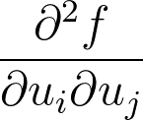
Hessian provides correlation between coordinates
characterize anisotropy in all direction
Notes:
In contrast, Hessian gives us information on all directions.
It tells us what happens to the function if we move two of the coordinates simultaneously
In other word, it gives us the correlation between sampling coordinates.
This is a very important information for us because we want to characterize the anisotropy in all directions at once.

Slide 21
Automatic differentiation provides gradient + Hessian
  no hand derivation
  metaprogramming approach
    chain rule applied automatically
  in practice, implement with special datatype
ADFloat f(const ADFloat x[2]) {
  ADFloat y = sin(x[0]);
  ADFloat z = cos(x[1]);
  return y * z;
}
e.g. [Griewank and Walther 2008]
Notes:
To compute gradients and Hessians, we use automatic differentiation.
It’s a metaprogramming approach that apply chain rule to your program automatically so that you don’t need to hand derive the derivatives.
Given your program that you want to differentiate, in practice, you replace the floating point type to a special datatype.
The type records the function so that the function becomes sequences of operations.
It then applies chain rule to the sequences to compute the derivatives of the function.

Slide 22
Automatic differentiation provides gradient + Hessian
  implement path contribution with automatic differentiation datatypes
    normal, BRDF, light source
    derivatives w.r.t path vertex coordinates
ADFloat f(const ADFloat x[2]) {
  ADFloat y = sin(x[0]);
  ADFloat z = cos(x[1]);
  return y * z;
}
e.g. [Griewank and Walther 2008]
Notes:
To apply automatic differentiation to our renderer, we have to implement the whole path contribution function with that special datatype.
Therefore the derivatives take account for the full path contribution including normal, BRDF, and emission profile of the light source.
The derivatives are taken with respect to path vertex coordinates that parameterizes the light path.

Slide 23
Quadratic approximation of contribution
gradient + Hessian (2nd-order Taylor)
around current sample
original contribution
(only known at sample)
Notes:
To have more intuitions about what gradients and Hessian gives us, let’s look at the original contribution function here.
Remember that we only know the contribution at the current sample.
However, the gradient and Hessian of the current sample gives us a quadratic approximation about its neighborhood

Slide 24
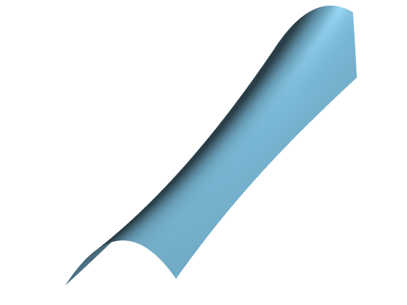
Quadratic approximation of contribution
gradient + Hessian (2nd-order Taylor)
around current sample
quadratic approximation
(known everywhere)
Notes:
The quadratic approximation looks like this. It’s an approximation so it’s different, but you see when i’m flipping between the slides, it captures the local shape of the contribution function.
Now, instead of one point, we have a whole quadratic function to reason about, and that’s a lot of information.
The problem now is how to utilize this information.

Slide 25
Recap
quadratic approximation
at current sample
challenge:
sample quadratic
Notes:
To recap, now we have a quadratic approximation around a sample, computed by automatic differentiation.
The quadratic approximation characterizes the anisotropy of the function.
We want to sample from the quadratic so that the proposal has high probability to land on high contribution region

Slide 26
Quadratics are not distributions!
Can go to +/- infinity
Notes:
As I said this is not trivial because the quadratics can grow to infinity and do not define a distribution.
We cannot just apply something like inversion sampling to the quadratic and hope we can get the proposal.

Slide 27
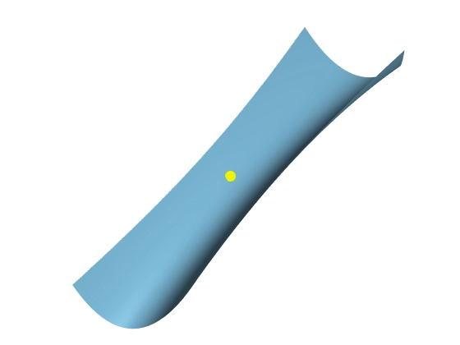
Goal: attract samples to high contribution regions
idea: flip landscape and simulate gravity
  Hamiltonian Monte Carlo [Duane et al. 1987]
gravity
quadratic landscape
flipped quadratic landscape
Notes:
Therefore we borrow ideas from Hamiltonian Monte Carlo.
The goal is to attract samples to high contribution regions.
The idea is to flip the landscape, so that high contribution region are now at low ground.
We then simulate physics on the landscape, so that gravity will attract samples to low ground.

Slide 28

Hamiltonian Monte Carlo simulates physics
  flip contribution landscape
  start from current sample with random velocity
Random
initial velocity
gravity
flipped quadratic landscape
￼
Notes:
Let me be a little bit more specific.
Now we have flipped the contribution landscape.
Imagine we put a particle at the current sample location.
We give the particle a random initial velocity, so the particle will roll on the landscape.

Slide 29
Hamiltonian Monte Carlo simulates physics
  flip contribution landscape
  start from current sample with random velocity
  simulate physics under gravity
    particle is pulled to low ground (high contribution)
  proposal is final position
gravity
flipped quadratic landscape
￼
Notes:
Because of gravity, the particle will be pulled to low ground.
And because we have flipped the contribution landscape, low ground now represents high contribution area.
We record the final position of the particle after some fixed time

Slide 30
Challenge with traditional Hamiltonian Monte Carlo
expensive numerical simulation!
flipped quadratic landscape
gravity
Notes:
Unfortunately, it is not feasible for us to apply traditional Hamiltonian Monte Carlo directly.
In its original form, Hamiltonian Monte Carlo requires expensive numerical simulation to do the physics.
In our case it means we have to do all the ray tracing, shading, and derivatives computation along the trajectory.
Fortunately, in this particular case of quadratic surfaces, and if the initial random velocity is Gaussian, we have a closed-form solution.

Slide 31

HMC + quadratic has a closed form
for Gaussian initial velocity
Gaussian
initial velocity
gravity
Notes:
To demonstrate the closed-form solution,
recall that the particle is given a randomized initial velocity.
In our case we assume it is Gaussian distributed.
If you give the particle a different velocity, it ends up at different locations.
and if you try this many many times…

Slide 32
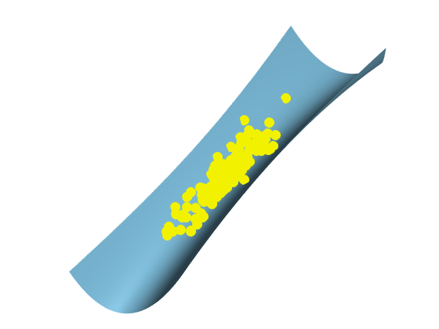
HMC + quadratic has a closed form
for Gaussian initial velocity
final positions are Gaussian!
gravity
Notes:
You can observe that the end position of these particles form a gaussian distribution.
It turns out that Hamiltonian dynamics is a linear operation on the Gaussian velocity variable.
So essentially Hamiltonian dynamics transforms the velocity Gaussian to another Gaussian representing the final positions.
It means that we can do all the Hamiltonian Monte Carlo business to sample the quadratic surface,
by sampling from an anisotropic Gaussian, whose mean and covariance matrix can be derived from the quadratic surface and Gaussian initial velocity.

Slide 33
Recap
use 2nd derivatives (Hessian)
to characterize anisotropy
→quadratic approximation
simulate Hamiltonian dynamics
to sample from quadratics
results in closed-form Gaussian
Notes:
To recap, given the current sample,
we use its Hessian as well as gradient to characterize the anisotropy of the contribution function.
This gives us a quadratic approximation around current sample.
We want to sample from the quadratic approximation.
However, the quadratic does not define a distribution.
So we simulate Hamiltonian dynamics to sample from quadratics.
This results in a closed-form Gaussian, so we can just sample from this Gaussian.

Slide 34
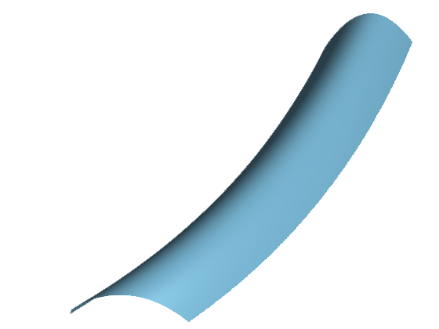
Recap
Given current sample
  compute gradient and Hessian
  compute anisotropic Gaussian
  draw proposal
  probabilistically accept
  repeat
Notes:
Recall that we build our method on Metropolis light transport and we are generating a Markov chain.
So the full algorithm is:
given the current sample, we compute its gradient and Hessian
we then compute an anisotropic Gaussian based on Hamiltonian Monte Carlo and the gradient and Hessian
we draw a proposal from the Gaussian, and probabilistically accept it
if accept, then current sample become the accepted proposal
and we repeat the process

Slide 35
Results: Bathroom
Notes:
Let’s look at the result.
Here is our test scene, rendered by our method in 10 minutes.
The scene contains many glossy materials.
For example, the metal ring is causing some caustics on the right.
And the glossy bathtub is reflecting the light from the whole room.
I want you to focus on two regions where there are some highly curved glossy surfaces involved.

Slide 36
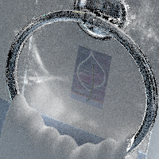
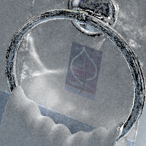
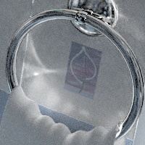
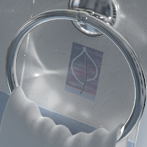
Bathroom: equal-time (10 mins) comparisons
MMLT
[Hachisuka 2014]
MEMLT
[Jakob 2012]
HSLT
[Kaplanyan 2014,
Hanika 2015]
OURS
Reference (2 days)
Notes:
Here is the equal-time comparison of one of the insets between the methods.
We compare with three other metropolis light transport algorithms.
The highly-curved metal ring is troublesome for all the other methods.
Multiplexed Metropolis light transport, aka MMLT, uses isotropic mutation and cannot handle anisotropic integrand well.
Manifold exploration and Half-vector space light transport, aka MEMLT and HSLT, which are the specialized methods I mentioned when I was talking about previous work, cannot explore the contribution function efficiently because they need to sample some coordinates first, then resolve the rest using some constraints, and it is possible that during the first pass they jump into some space where it is impossible to satisfy the constraint.
Our method is pretty good at resolving the correlation between coordinates using second-derivatives even with the highly-curved surfaces.

Slide 37





Bathroom: equal-time (10 mins) comparisons
MMLT
[Hachisuka 2014]
MEMLT
[Jakob 2012]
HSLT
[Kaplanyan 2014,
Hanika 2015]
OURS
Reference (2 days)
Notes:
Here is another example where there are some fast changing normals on the edges.
This is pretty troublesome for MLT algorithms because you need to sample on the edges to keep staying on high contribution region.
Again, we can handle this pretty well.

Slide 38
Extension to time
Our method is general thanks to automatic differentiation
Notes:
This is another scene showing the generality of our method.
Specifically, our method is able to resolve the correlation between the time dimension and the path-space, thanks to automatic differentiation.

Slide 39
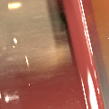
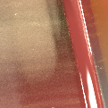
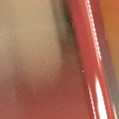
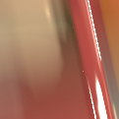
Cars: equal-time (20 mins) comparisons
MMLT
[Hachisuka 2014]
MEMLT
[Jakob 2012]
OURS
Reference (12 hours)
Notes:
Here is a closer look.
We do not show the result of HSLT here because their implementation does not support motion blur.
MMLT sometimes trapped in the very narrow region and produced some correlated noise.
Manifold Exploration produces ghosting artifacts because they do not move in time dimension.
Again, our method can resolve the correlation between time and path-space and did it quite well in this case.

Slide 40
Conclusion
Good anisotropic proposals for Metropolis
  Hessian from automatic differentiation
  Hamiltonian Monte Carlo
  Closed-form Gaussian
  General, easily extended to time
Notes:
To conclude, we proposed an algorithm where the goal is to generate good proposals for Metropolis Light Transport.
We use Hessian computed by automatic differentiation to characterize the anisotropy of the integrand.
We then use Hamiltonian Monte Carlo to sample from the quadratic approximation.
This results in a closed-form Gaussian so we can just sample from the Gaussian.
Our method is general, thanks to automatic differentiation.
For example, it can be easily extended to sample time dimension.

